Slide 1
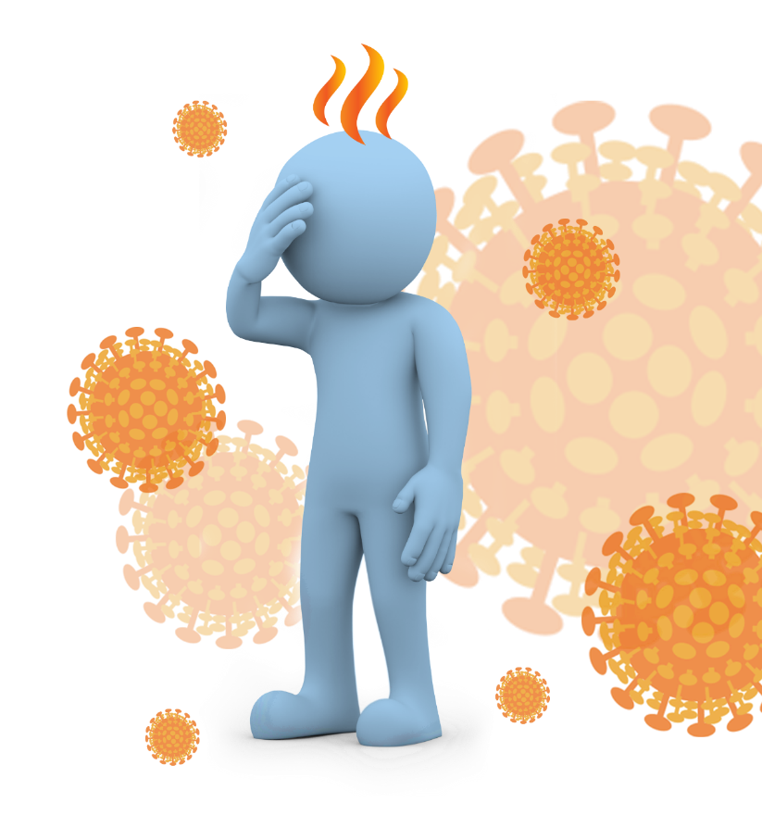
Coronavirus Disease 2019 (COVID-19)
What you need to know
Version 4.0
Disclaimer: This presentation has been developed for educational purposes only. It is not a substitute for professional medical advice. Should you have questions or concerns about any topic described here, please consult your medical professional.
© 2020 AEA International Holdings Pte. Ltd. All rights reserved.
Notes:
Content was last updated by International SOS – date 11th March 2020
Content is subject to change. Version 4.0 Feedback and comments email to healthpromotion@internationalsos.com

Slide 2
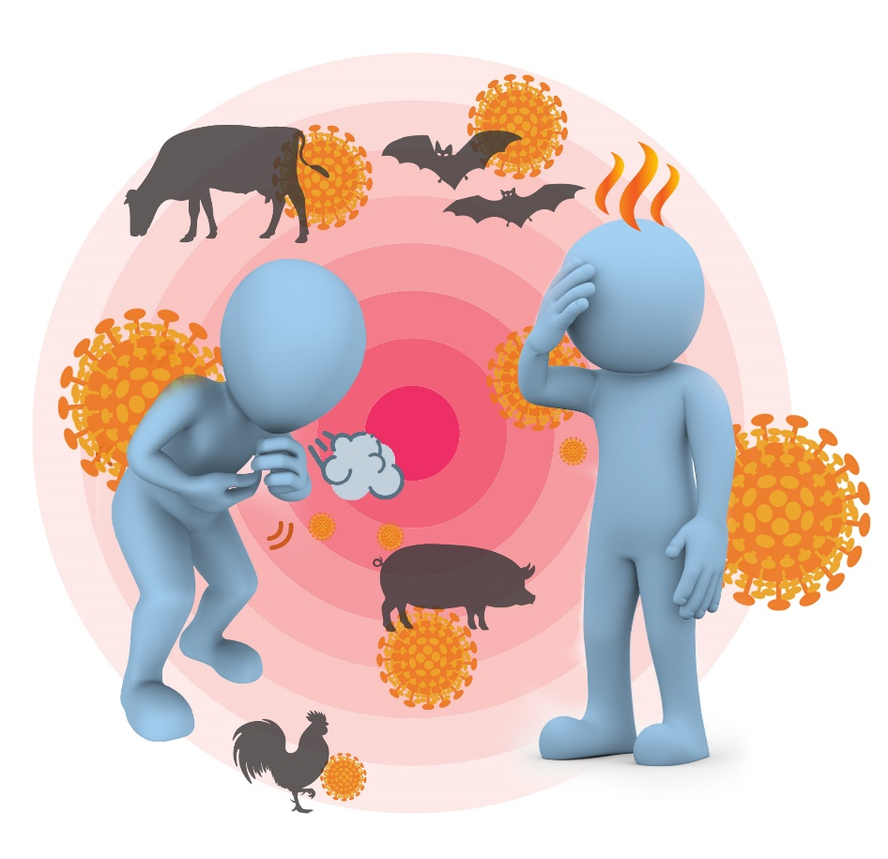
Severe acute respiratory syndrome coronavirus 2 (SARS-CoV-2) causes COVID-19
SARS-CoV-2 is a new virus.
The first cases were identified in people with pneumonia in Wuhan, China, in late December 2019.
It probably started in animals but is now spreading between people.
As this virus is new, we are learning more all the time, and what we know now may change.

Slide 3
Travellers have brought the virus into other countries
Many countries have now detected the virus in travellers.
Some people who were in contact with these travellers were infected by them.
It is possible that other locations will have cases of COVID-19.
Although there is a lot we don’t know yet about this new virus, we can still prevent the disease and stop an outbreak.

Slide 4
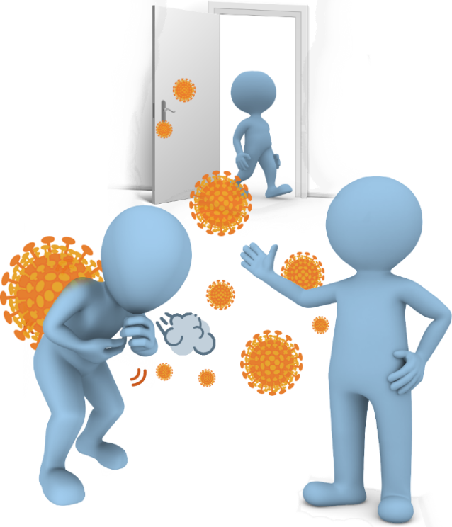
How is it spread?
Most people are being infected from other people.
It probably spreads the same way as colds and flu – through droplets which are created when we talk, cough and sneeze.
People can get infected when these droplets enter the nose, eyes or mouth.
Touching contaminated objects puts the droplets onto your hands. If you touch your face the droplets can enter your nose / eyes / mouth.
Some other coronaviruses have spread through faeces, and COVID-19 might also spread this way.

Slide 5
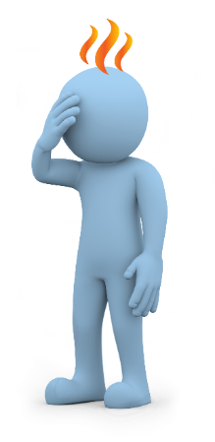
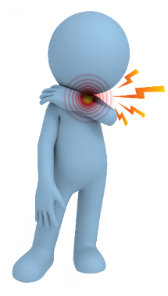
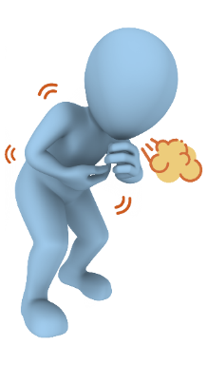
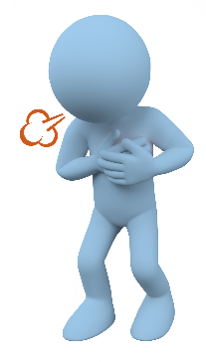
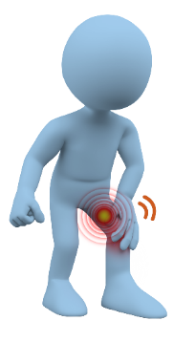
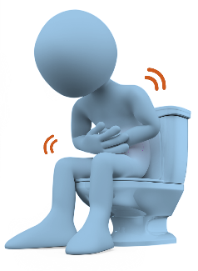
Symptoms start like many other illnesses
Fever
Sore throat
Cough
Shortness of breath
Muscle aches
Diarrhoea
Symptoms start about one day after exposure, but can be as long as 14 days.
Some people have no symptoms, most have a mild illness. It can be severe and sometimes fatal.

Slide 6
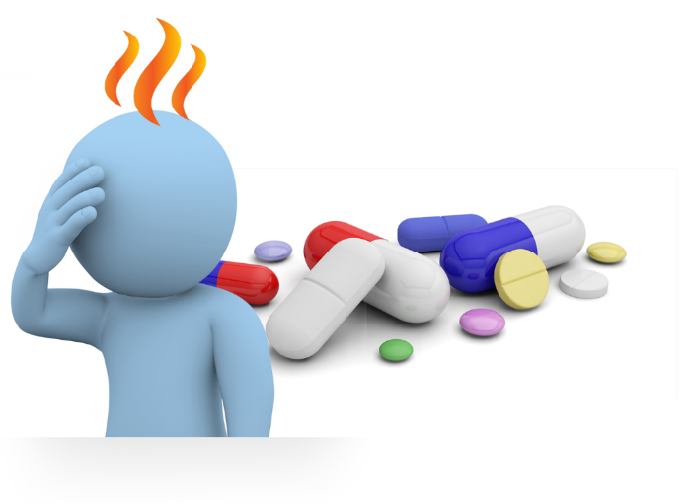
Diagnosis and treatment
Because symptoms are similar to many other illnesses, tests are needed to make the diagnosis (throat swab, blood test).
There is no specific treatment.
Mild symptoms can be treated with medicine to lower the fever, or relieve pain.
If symptoms are more severe, treatment in hospital is required.

Slide 7
To prevent COVID-19
Maintain good personal hygiene
Wash your hands frequently with soap and water.
Use alcohol-based hand sanitiser when soap and water are not readily available.
Cover your coughs and sneezes. Use a tissue or your upper sleeve. Immediately throw the tissue in a bin and wash your hands.
Anyone who has any symptoms even if only mild should stay home and seek medical advice.

Slide 8
Avoid exposure
Avoid touching your face (eyes, nose and mouth) – especially if you have touched objects handled by many people (such as handrails, door handles).
Do not share food, drinks and personal items.

Slide 9
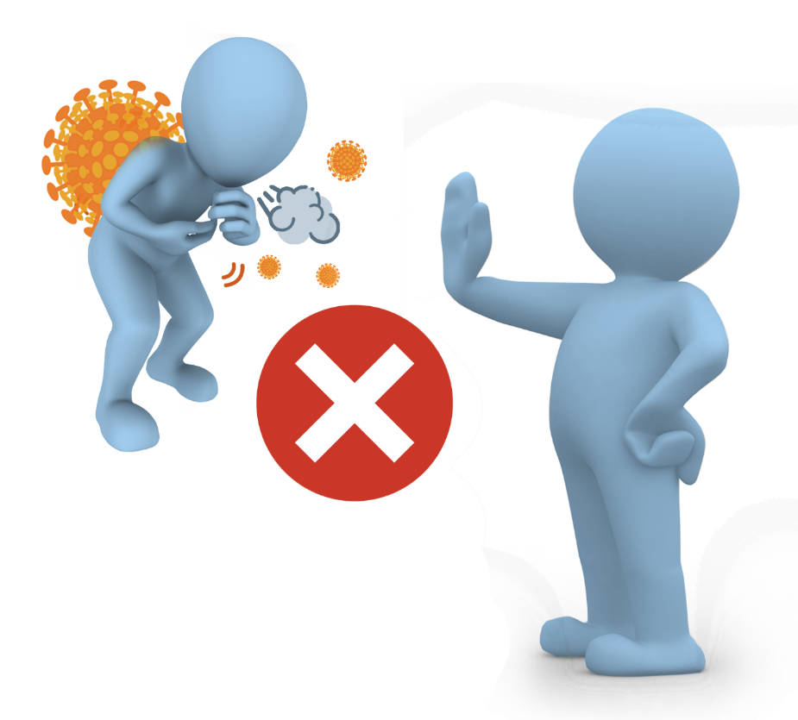
Avoid exposure
Keep away from people who are sick – don’t let them cough or sneeze on you.
Avoid activities which expose you to large groups of people.
When in public areas, as much as possible, keep 1-2 metres distance from other people.
Get the flu shot – this will reduce the risk of seasonal flu and possible confusion with COVID-19 symptoms.

Slide 10
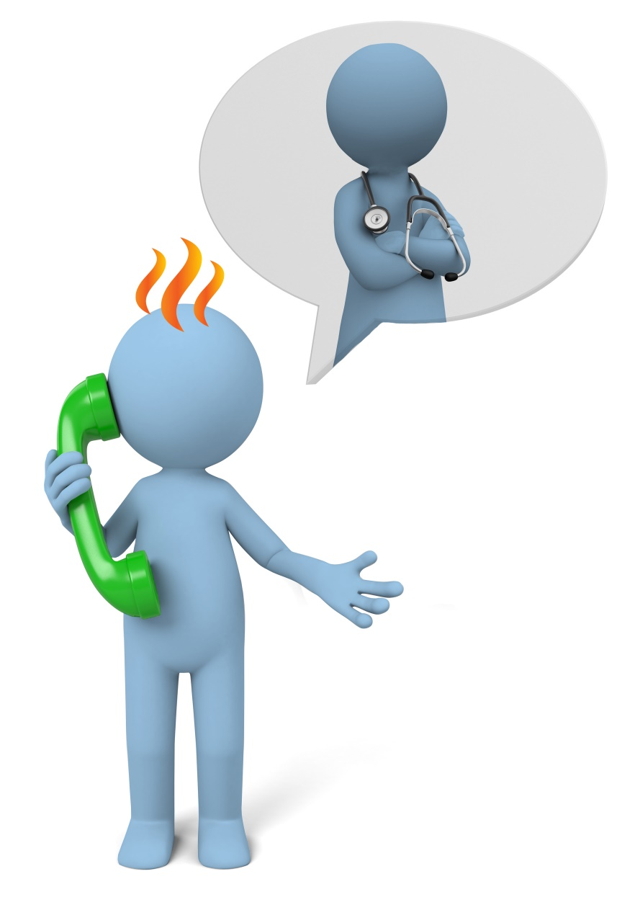
After travel to an affected area
Monitor your health.
Seek medical attention if you develop symptoms, following the local procedure for your location.
When travelling to medical care, consider wearing a mask, use private transport and avoid contact with others as much as possible.
Ensure you provide your travel history to the medical facility.

Slide 11
What to do if you get sick
Do not travel
Cover your coughs and sneezes – use a tissue or a mask if available – and wash your hands with soap and water.
Seek medical attention – let the doctor know if you have travelled recently, and if you were in contact with someone who is sick.
If you don’t need to go to hospital – stay home as much as possible. Do not go to work. Minimise contact with other people until you have recovered.

Slide 12
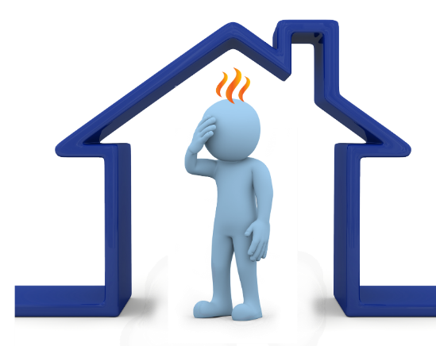
Screening and contact tracing
Is important to stop the spread of the virus
“Screening” may be done at entry points to detect sick people. You may be asked where you have been, and your temperature may be taken.
Health authorities may perform “contact tracing” – identifying people who have been in contact with someone with COVID-19.
These ‘contacts’ may be asked
to stay at home for 14 days so they don’t infect other people.
to monitor their health for 14 days in case they develop symptoms.
Follow the advice of health authorities.

Slide 13
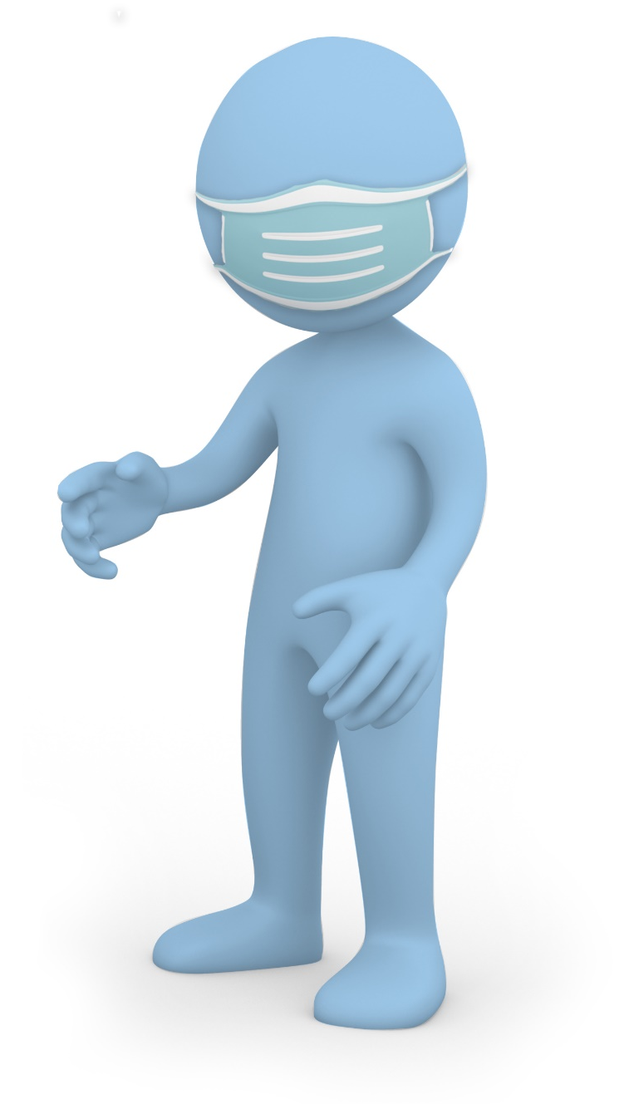
When to use masks
Healthy people don’t need to wear masks.
Wear a mask if:
You are coughing or sneezing
You are caring for a sick person at home or in healthcare setting
Masks alone don’t protect – they should be used along with other hygiene measures.
Follow manufacturer’s advice for using the mask.

Slide 14
More information on COVID-19
Keep up to date with news and information from the International SOS dedicated website: https://pandemic.internationalsos.com/2019-ncov

Slide 15
Any questions
Disclaimer: This presentation has been developed for educational purposes only. It is not a substitute for professional medical advice. Should you have questions or concerns about any topic described here, please consult your medical professional.
© 2020 AEA International Holdings Pte. Ltd. All rights reserved.
Notes:
Feedback and comments email to healthpromotion@internationalsos.com

